Slide 1


REACT ES6 - Classes
React is much easier to learn if you know ES6.

Slide 2
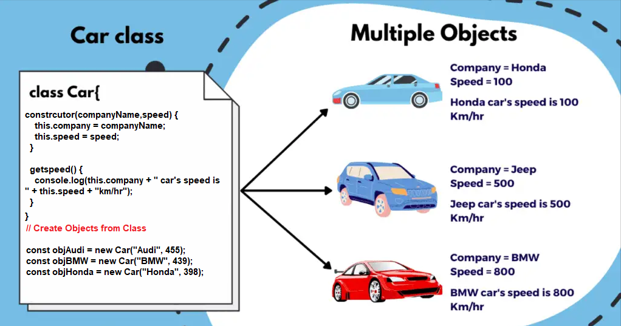
cLASSES
ES6 introduced classes.
ES6 JavaScript supports the OOP components and there are three concepts Object, Class and Methods.
Class: Class is a blueprint or template from which objects are created. Object: A real-time object entity means the presentation of any entity in real-time. Methods: It communicates between the objects.

Slide 3
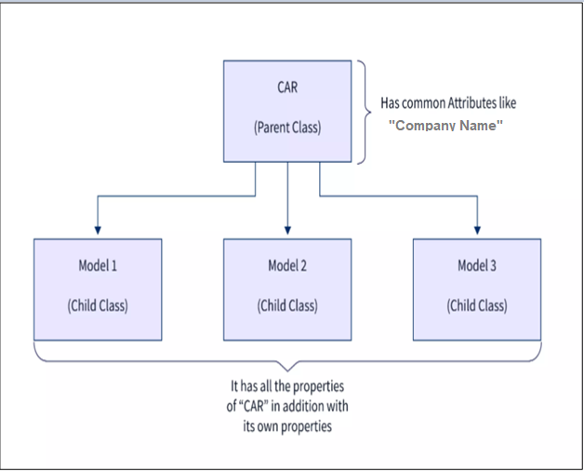
Class inheritance
To create a class inheritance, use the extends keyword. Create a class named "Model" which will inherit the methods from the "Car" class.
The super() method refers to the parent class.

